Slide 1
Transaction Management
Using SpringBoot

Slide 2
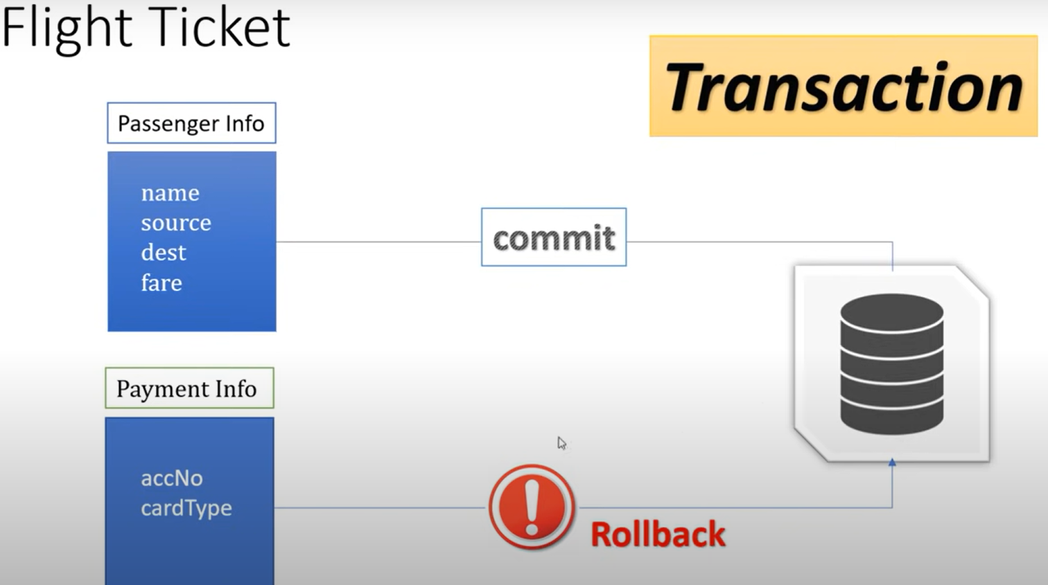

Slide 3
Helps Achieving ACID properties
Atomicity: The transaction is treated as a single unit. Either all operations within the transaction are completed successfully, or none are applied.
Consistency: The transaction must leave the database in a consistent state. It should adhere to all defined rules and constraints.
Isolation: Transactions are executed in isolation from each other. Intermediate results are not visible to other transactions until the transaction is complete.
Durability: Once a transaction is committed, its changes are permanent and survive system failures.

Slide 4
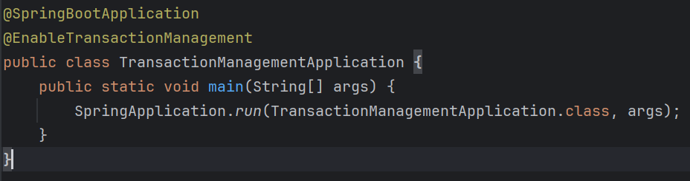
@EnableTransactionManagement

Slide 5
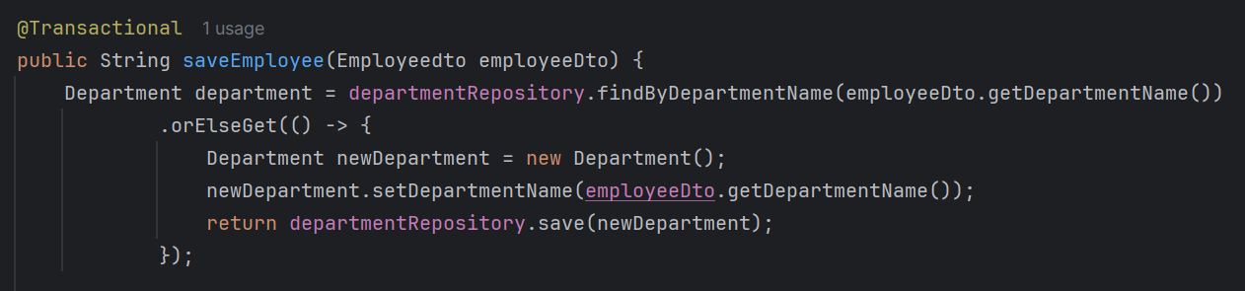
@Transactional

Slide 6
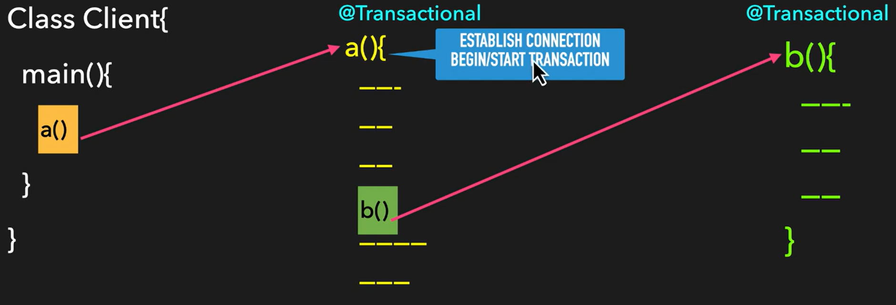
Transaction Propagation

Slide 7
Types of Transaction Propagation
REQUIRED
SUPPORTS
NOT_SUPPORTED
REQUIRES_NEW
NEVER
MANDATORY

Slide 8
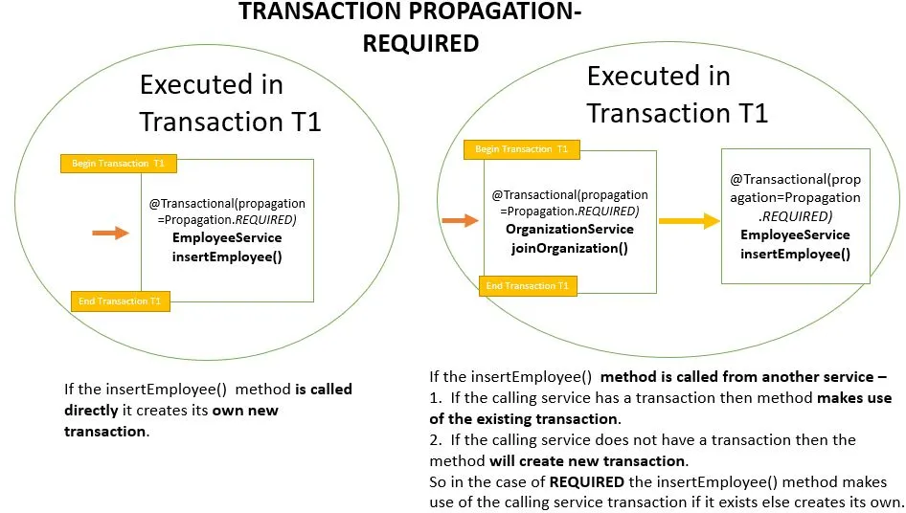

Slide 9
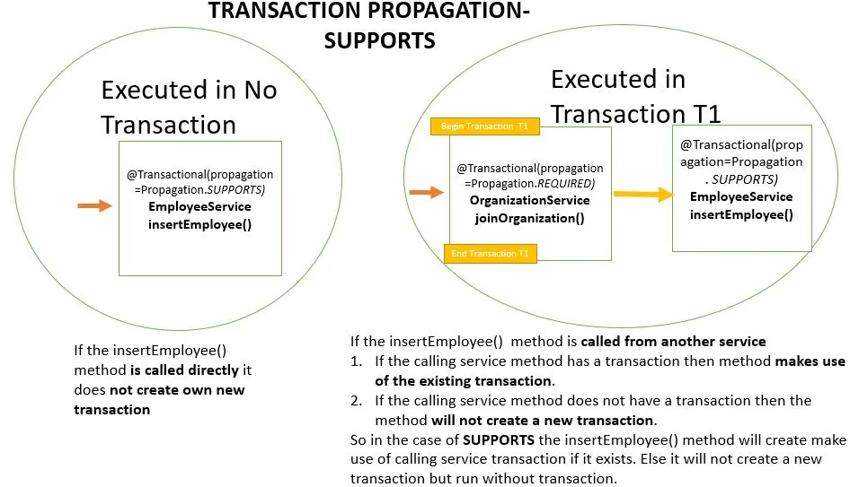

Slide 10
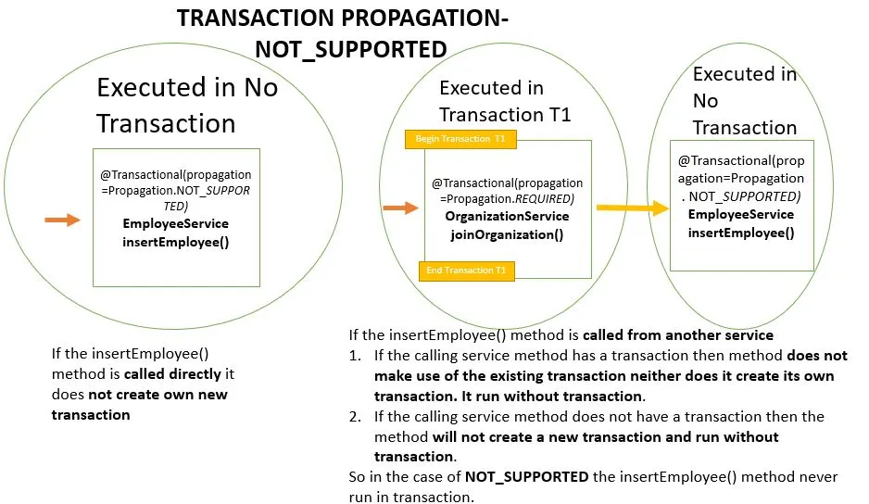

Slide 11
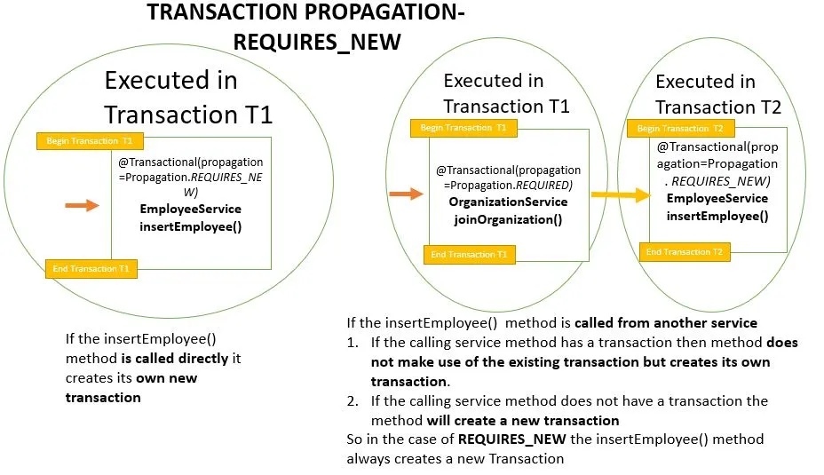

Slide 12
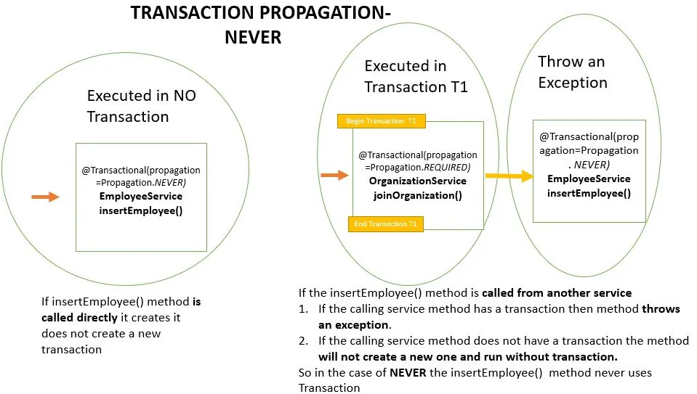

Slide 13
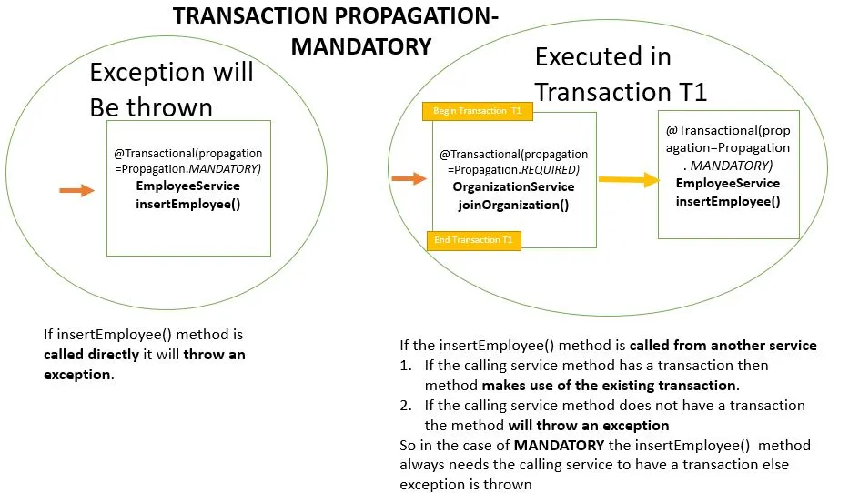

Slide 14
Project Demo

Slide 15
THANK YOU
Any queries

